Slide 1
File structure and Data Administration
UNIT -IV

Slide 2
File Organization,
Overview of Physical Storage Media,
Magnetic Disk,
RAID,
Tertiary Storage
Storage Access,
Data Dictionary Storage,
Organization of File (Sequential, Clustering),

Slide 3
Indexing and Hashing,
Basic Concepts,
indices,
B+ Tree index file,
B- tree index file,
Static hashing,
Dynamic Hashing,

Slide 4
Data administration,
Role and Responsibility of DBA,
Creating/Deleting/Updating table space,
Database Monitoring,
User Management

Slide 5
What is Physical Storage Media
The data in database management system (DBMS) is stored on physical storage devices such as main memory and secondary (external) storage. Thus, it is important that the physical database (or storage) is properly designed to increase data processing efficiency and minimise the time required by users to interact with the information system.

Slide 6
Classification of Physical Storage Media
Speed with which data can be accessed
Cost per unit of data
Reliability
data loss on power failure or system crash
physical failure of the storage device
Can differentiate storage into: ( types of storage media)
volatile storage: loses contents when power is switched off
non-volatile storage:/ Secondary Memory
Contents persist even when power is switched off.
Includes secondary and tertiary storage, as well as batter- backed up main-memory.

Slide 7
Volatile/ Primary storage
Cache – fastest and most costly form of storage; volatile; managed by the computer system hardware.
Main memory:
fast access (10s to 100s of nanoseconds; 1 nanosecond = 10^{–9} seconds)
generally too small (or too expensive) to store the entire database
capacities of up to a few Gigabytes widely used currently
Capacities have gone up and per-byte costs have decreased steadily and rapidly (roughly factor of 2 every 2 to 3 years)

Slide 8
Flash memory
Data survives power failure
Data can be written at a location only once, but location can be erased and written to again
Can support only a limited number (10K – 1M) of write/erase cycles.
Erasing of memory has to be done to an entire bank of memory
Reads are roughly as fast as main memory
But writes are slow (few microseconds), erase is slower
Widely used in embedded devices such as digital cameras, phones, and USB keys

Slide 9
Secondary Storage
Magnetic-disk
Data is stored on spinning disk, and read/written magnetically
Primary medium for the long-term storage of data; typically stores entire database.
Data must be moved from disk to main memory for access, and written back for storage
Much slower access than main memory (more on this later)
direct-access – possible to read data on disk in any order, unlike magnetic tape
Capacities range up to roughly 1.5 TB as of 2009
Much larger capacity and cost/byte than main memory/flash memory
Growing constantly and rapidly with technology improvements (factor of 2 to 3 every 2 years)
Survives power failures and system crashes
disk failure can destroy data, but is rare

Slide 10
Optical storage
non-volatile, data is read optically from a spinning disk using a laser
CD-ROM (640 MB) and DVD (4.7 to 17 GB) most popular forms
Blu-ray disks: 27 GB to 54 GB
Write-one, read-many (WORM) optical disks used for archival storage (CD-R, DVD-R, DVD+R)
Multiple write versions also available (CD-RW, DVD-RW, DVD+RW, and DVD-RAM)
Reads and writes are slower than with magnetic disk

Slide 11
Tape storage
non-volatile, used primarily for backup (to recover from disk failure), and for archival data
sequential-access – much slower than disk
very high capacity (40 to 300 GB tapes available)
tape can be removed from drive ⇒ storage costs much cheaper than disk, but drives are expensive
Tape jukeboxes available for storing massive amounts of data
hundreds of terabytes (1 terabyte = 10⁹ bytes) to even multiple petabytes (1 petabyte = 10¹² bytes)

Slide 12
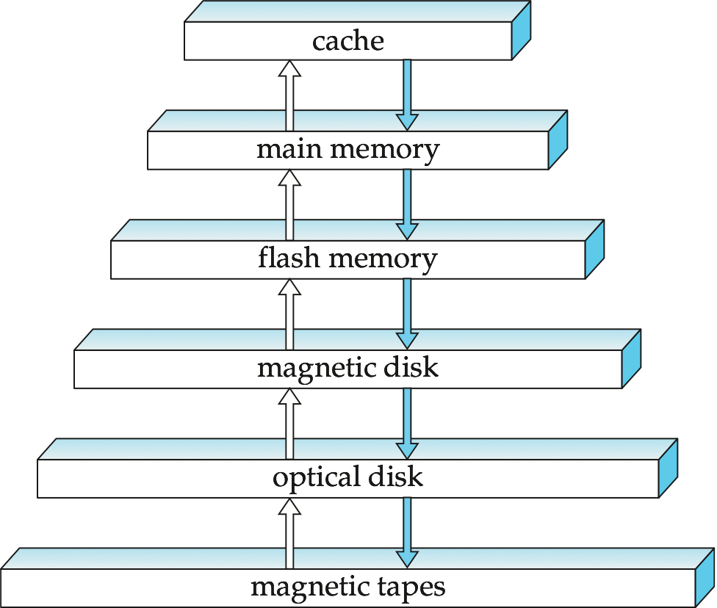
Storage Hierarchy

Slide 13
primary storage: Fastest media but volatile (cache, main memory).
secondary storage: next level in hierarchy, non-volatile, moderately fast access time
also called on-line storage
E.g. flash memory, magnetic disks
tertiary storage: lowest level in hierarchy, non-volatile, slow access time
also called off-line storage
E.g. magnetic tape, optical storage

Slide 14
RAID
RAID: Redundant Arrays of Independent Disks
disk organization techniques that manage a large numbers of disks, providing a view of a single disk of
high capacity and high speed by using multiple disks in parallel,
high reliability by storing data redundantly, so that data can be recovered even if a disk fails
The chance that some disk out of a set of N disks will fail is much higher than the chance that a specific single disk will fail.
Techniques for using redundancy to avoid data loss are critical with large numbers of disks

Slide 15
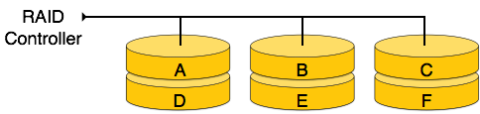
RAID 0
In this level, a striped array of disks is implemented. The data is broken down into blocks and the blocks are distributed among disks. Each disk receives a block of data to write/read in parallel. It enhances the speed and performance of the storage device. There is no parity and backup in Level 0.

Slide 16
RAID 0
Minimum number of drives: 2
Strengths: Highest performance.
Weaknesses: No data protection; One drive fails, all data is lost.

Slide 17
RAID 1: Also known as disk mirroring, this configuration consists of at least two drives that duplicate the storage of data. There is no striping. Read performance is improved since either disk can be read at the same time. Write performance is the same a
RAID 1
Disk mirroring.
Minimum number of drives: 2
Strengths: Very high performance; Very high data protection; Very minimal penalty on write performance.
Weaknesses: High redundancy cost overhead; Because all data is duplicated, twice the storage capacity is required.
s for single disk storage.

Slide 18
Improvement of Reliability via Redundancy
Redundancy – store extra information that can be used to rebuild information lost in a disk failure
E.g., Mirroring (or shadowing)
Duplicate every disk. Logical disk consists of two physical disks.
Every write is carried out on both disks
Reads can take place from either disk
If one disk in a pair fails, data still available in the other
Data loss would occur only if a disk fails, and its mirror disk also fails before the system is repaired
Probability of combined event is very small
Except for dependent failure modes such as fire or building collapse or electrical power surges
Mean time to data loss depends on mean time to failure, and mean time to repair

Slide 19
File Organization, Record Organization and Storage Access

Slide 20
File Organization
The database is stored as a collection of files. Each file is a sequence of records. A record is a sequence of fields.
What is File Organization? File Organization refers to the logical relationships among various records that constitute the file, particularly with respect to the means of identification and access to any specific record. In simple terms, Storing the files in certain order is called file Organization. File Structure refers to the format of the label and data blocks and of any logical control record.

Slide 21
Objective of file organization
It contains an optimal selection of records, i.e., records can be selected as fast as possible.
To perform insert, delete or update transaction on the records should be quick and easy.
The duplicate records cannot be induced as a result of insert, update or delete.
For the minimal cost of storage, records should be stored efficiently.

Slide 22
Record Type
Fixed length record Variable length record

Slide 23
Fixed-Length Records
In a file with fixed length record. All records on the page are of the same slot length.
Simple approach:
Store record i starting from byte n ∗ (i – 1), where n is the size of each record.
Record access is simple but modification: do not allow records to cross block boundaries

Slide 24
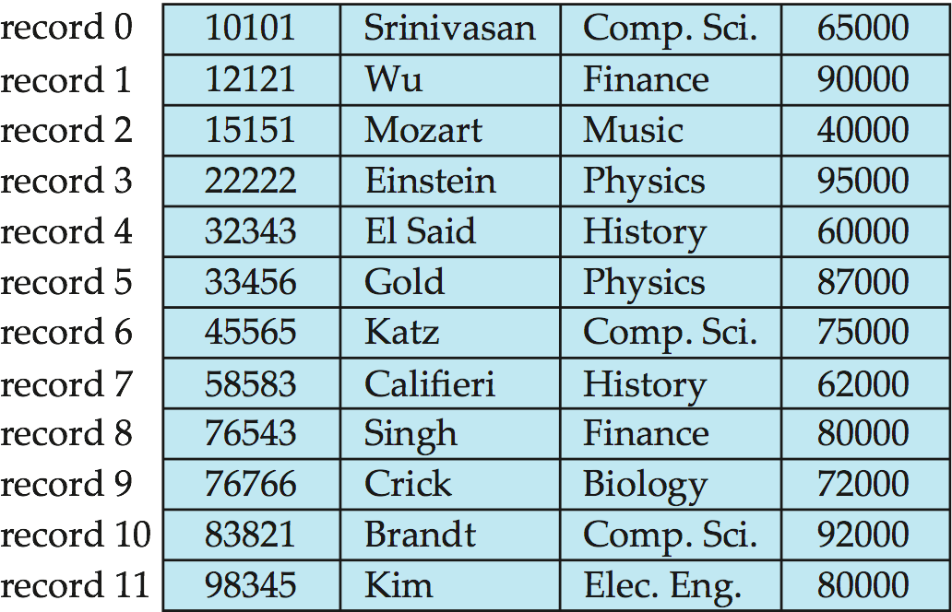

Slide 25
Variable-Length Records
All records on the page are not of the same length. Different record in a file have different size.
Variable-length records arise in database systems in several ways:
Storage of multiple record types in a file.
Record types that allow variable lengths for one or more fields such as strings (varchar)
Record types that allow repeating fields (used in some older data models).

Slide 26
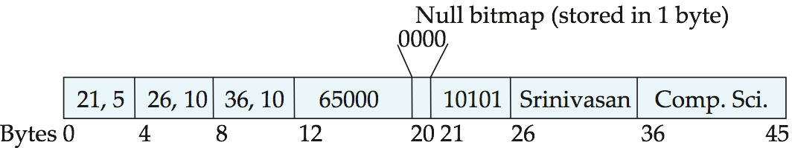
Attributes are stored in order
Variable length attributes represented by fixed size (offset, length), with actual data stored after all fixed length attributes
Null values represented by null-value bitmap

Slide 27
Organization of Records in Files / File organisation
1. Heap – a record can be placed anywhere in the file where there is space
2. Sequential – store records in sequential order, based on the value of the search key of each record
3. Hashing – a hash function computed on some attribute of each record; the result specifies in which block of the file the record should be placed

Slide 28
Sequential File Organization
A sequential file is a set of contiguously stored record on a physical starage device such as magnetic disk. Tape or CD ROM. In sequential file organization, records are placed in the file in some sequential order based on the unique key field or search key.
In sequential file organization, records are placed in the file in some sequential order based on the unique key field or search key.

Slide 29
Updating usually requires the creation of a new file. To maintain file sequence records are copied to the point where amendment is required. The changes are then made and copied to the new file. Following this, the remaining records in the original file are copied to the new file, thus creating an automatic back-up copy.
The basic advantage offered by a sequential file is the ease of access to the next record, the simplicity of the organization and the absence of auxiliary data structures. To reduce the cost per update, all updates are batched, sorted in order of sequential file and the file is updated in single pass, such a file containing updates to be made to sequential file is sometimes referred to as ‘Transaction File’

Slide 30
Advantages of Sequential File Organization
The design is very simple compared other file organization. There is no much effort involved to store the data.
When there are large volumes of data, this method is very fast and efficient. This method is helpful when most of the records have to be accessed like calculating the grade of a student, generating the salary slips etc where we use all the records for our calculations
This method is good in case of report generation or statistical calculations.
These files can be stored in magnetic tapes which are comparatively cheap.

Slide 31
Disadvantages of Sequential File Organization
Sorted file method always involves the effort for sorting the record. Each time any insert/update/ delete transaction is performed, file is sorted. Hence identifying the record, inserting/ updating/ deleting the record, and then sorting them always takes some time and may make system slow.

Slide 32
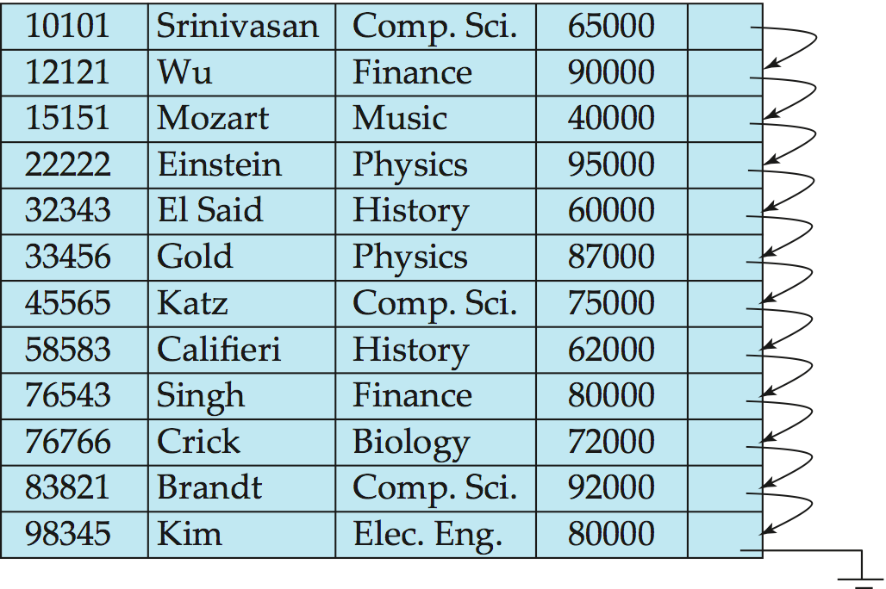
Sequential File Organization processing
Suitable for applications that require sequential processing of the entire file
The records in the file are ordered by a search-key

Slide 33
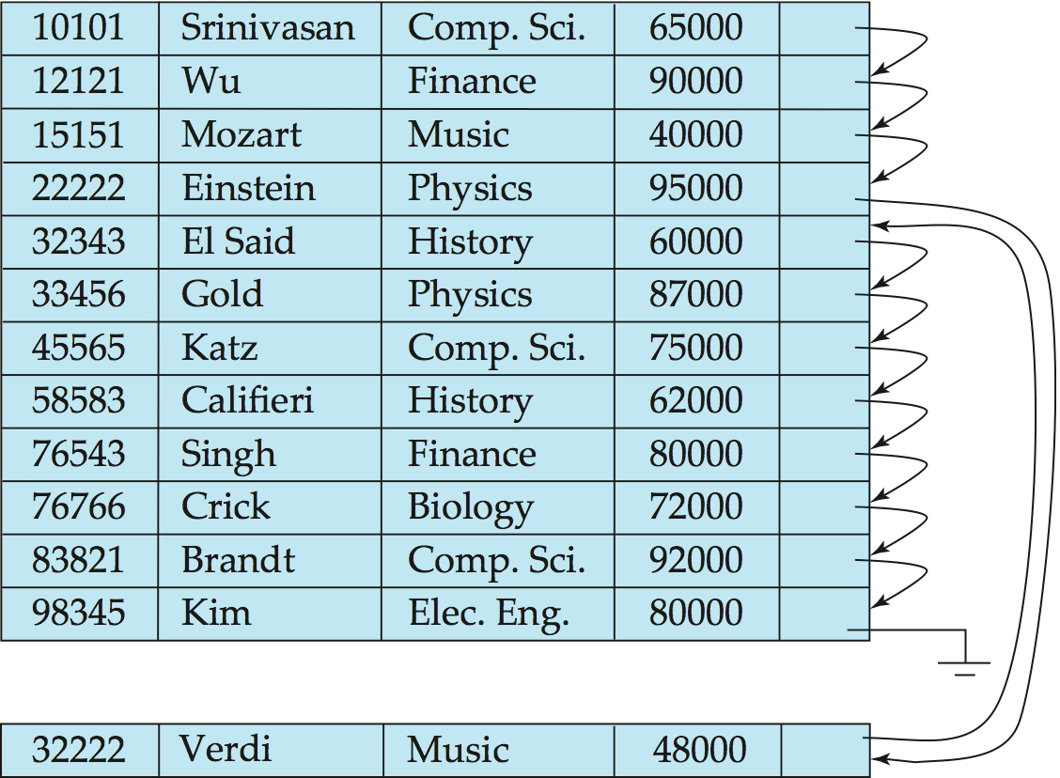
Sequential File Organization (Cont.)
Deletion – use pointer chains
Insertion –locate the position where the record is to be inserted
if there is free space insert there
if no free space, insert the record in an overflow block
In either case, pointer chain must be updated
Need to reorganize the file from time to time to restore sequential order

Slide 34
Index Sequential File
An Index sequential file organization is a direct processing method that combines the features of both sequential and direct access of record.
Here records are stored in order of primary key in the file. Using the primary key, the records are sorted. For each primary key, an index value is generated and mapped with the record. This index is nothing but the address of record in the file.

Slide 35
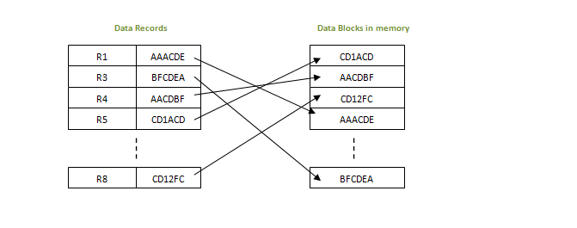
in this method, if any record has to be retrieved, based on its index value, the data block address is fetched and the record is retrieved from memory.

Slide 36
Advantages of ISAM
Since each record has its data block address, searching for a record in larger database is easy and quick. There is no extra effort to search records. But proper primary key has to be selected to make ISAM efficient.
This method gives flexibility of using any column as key field and index will be generated based on that. In addition to the primary key and its index, we can have index generated for other fields too. Hence searching becomes more efficient, if there is search based on columns other than primary key.

Slide 37
Disadvantages of ISAM
An extra cost to maintain index has to be afforded. i.e.; we need to have extra space in the disk to store this index value. When there is multiple key-index combinations, the disk space will also increase.

Slide 38
Hashing
Hashing is an efficient technique to directly search the location of desired data on the disk without using index structure. Data is stored at the data blocks whose address is generated by using hash function. The memory location where these records are stored is called as data block or data bucket.

Slide 39
Data bucket – Data buckets are the memory locations where the records are stored. These buckets are also considered as Unit Of Storage.
Hash Function – Hash function is a mapping function that maps all the set of search keys to actual record address. Generally, hash function uses primary key to generate the hash index – address of the data block. Hash function can be simple mathematical function to any complex mathematical function.
Hash Index-The prefix of an entire hash value is taken as a hash index. Every hash index has a depth value to signify how many bits are used for computing a hash function. These bits can address 2n buckets. When all these bits are consumed ? then the depth value is increased linearly and twice the buckets are allocated.

Slide 40
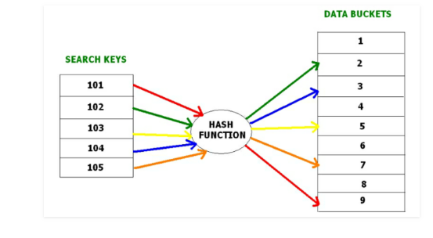

Slide 41
Advantage: data can be accessed directly and quickly
Centrally maintained data can be kept up to date
Disadvantage :
Because all data must be stored on disk, the hardware is expensive.

Slide 42
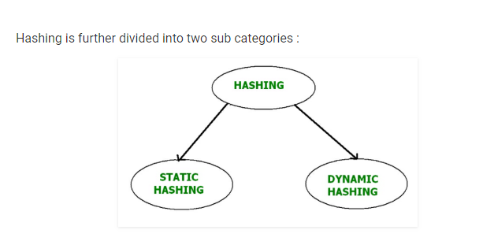

Slide 43
Static Hashing –
In static hashing, when a search-key value is provided, the hash function always computes the same address. For example, if we want to generate address for STUDENT_ID = 76 using mod (5) hash function, it always result in the same bucket address 4. There will not be any changes to the bucket address here. Hence number of data buckets in the memory for this static hashing remains constant throughout.

Slide 44
Operations – Insertion – When a new record is inserted into the table, The hash function h generate a bucket address for the new record based on its hash key K. Bucket address = h(K)
Searching – When a record needs to be searched, The same hash function is used to retrieve the bucket address for the record. For Example, if we want to retrieve whole record for ID 76, and if the hash function is mod (5) on that ID, the bucket address generated would be 4. Then we will directly got to address 4 and retrieve the whole record for ID 104. Here ID acts as a hash key.
Deletion – If we want to delete a record, Using the hash function we will first fetch the record which is supposed to be deleted. Then we will remove the records for that address in memory.

Slide 45
If we want to insert some new records into the file But the data bucket address generated by the hash function is not empty or the data already exists in that address. This becomes a critical situation to handle. This situation in the static hashing is called bucket overflow.
Open Hashing – In Open hashing method, next available data block is used to enter the new record, instead of overwriting older one. This method is also called linear probing.For example, D3 is a new record which needs to be inserted , the hash function generates address as 105. But it is already full. So the system searches next available data bucket, 123 and assigns D3 to it.

Slide 46
Dynamic Hashing –
The drawback of static hashing is that that it does not expand or shrink dynamically as the size of the database grows or shrinks. In Dynamic hashing, data buckets grows or shrinks (added or removed dynamically) as the records increases or decreases. Dynamic hashing is also known as extended hashing.
In dynamic hashing, the hash function is made to produce a large number of values. For Example, there are three data records D1, D2 and D3 . The hash function generates three addresses 1001, 0101 and 1010 respectively. This method of storing considers only part of this address – especially only first one bit to store the data. So it tries to load three of them at address 0 and 1.

Slide 47
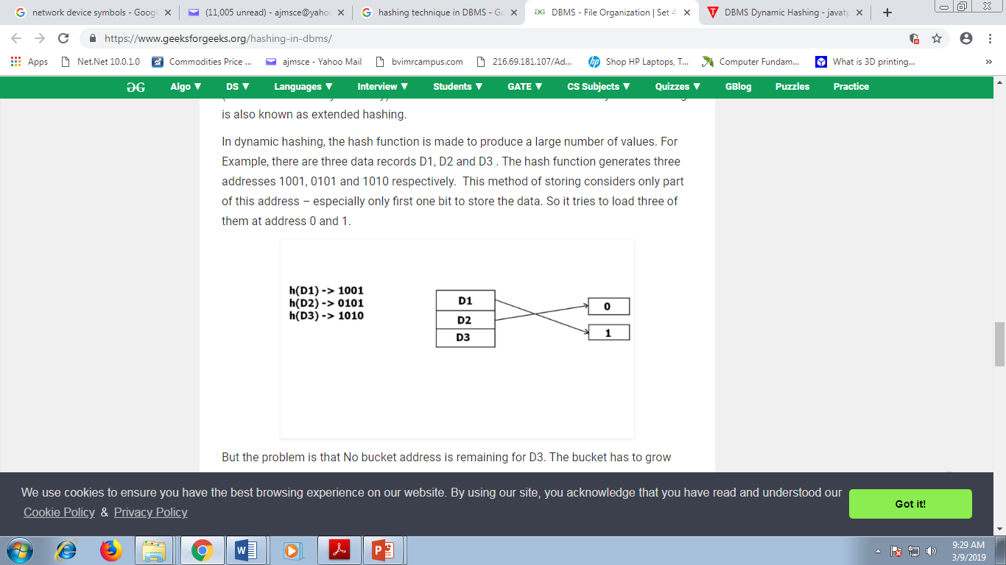

Slide 48
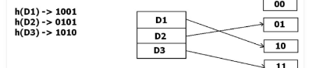
But the problem is that No bucket address is remaining for D3. The bucket has to grow dynamically to accommodate D3. So it changes the address have 2 bits rather than 1 bit, and then it updates the existing data to have 2 bit address. Then it tries to accommodate D3.

Slide 49
Heap File Organization
This is the simplest form of file organization. Here records are inserted at the end of the file as and when they are inserted. There is no sorting or ordering of the records. Once the data block is full, the next record is stored in the new block. This new block need not be the very next block. This method can select any block in the memory to store the new records. It is similar to pile file in the sequential method, but here data blocks are not selected sequentially.

Slide 50
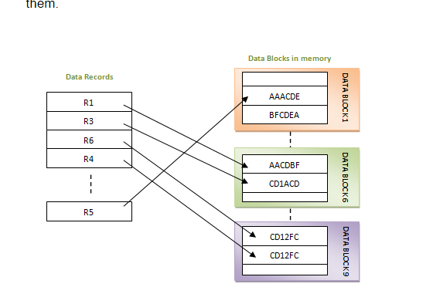

Slide 51
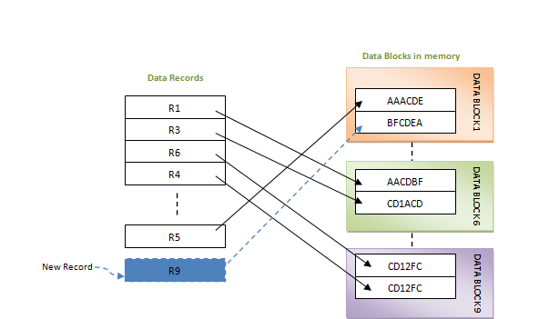
If a new record is inserted, then in the above case it will be inserted into data block 1.

Slide 52
Advantages of Heap File Organization
Very good method of file organization for bulk insertion. i.e.; when there is a huge number of data needs to load into the database at a time, then this method of file organization is best suited. They are simply inserted one after the other in the memory blocks.
It is suited for very small files as the fetching of records is faster in them. As the file size grows, linear search for the record becomes time consuming.

Slide 53
Disadvantages of Heap File Organization
This method is inefficient for larger databases as it takes time to search/modify the record.
Proper memory management is required to boost the performance. Otherwise there would be lots of unused memory blocks lying and memory size will simply be growing.

Slide 54
Indexing:
Indexing is a data structure technique to efficiently retrieve records from the database files based on some attributes on which the indexing has been done. Indexing in database systems is similar to what we see in books.

Slide 55
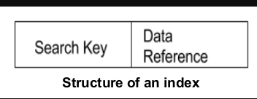
Indexes are created using some database columns.
The first column is the Search key that contains a copy of the primary key or candidate key of the table. These values are stored in sorted order so that the corresponding data can be accessed quickly (Note that the data may or may not be stored in sorted order).
The second column is the Data Reference which contains a set of pointers holding the address of the disk block where that particular key value can be found.

Slide 56
There are two kinds of indices:
Ordered indices: Indices are based on a sorted ordering of the values.
Hash indices: Indices are based on the values being distributed uniformly across a range of buckets. The buckets to which a value is assigned is determined by function called a hash function.

Slide 57
Primary Index
If the index is created on the basis of the primary key of the table, then it is known as primary indexing. These primary keys are unique to each record and contain 1:1 relation between the records.
As primary keys are stored in sorted order, the performance of the searching operation is quite efficient.
The primary index can be classified into two types: Dense index and Sparse index.

Slide 58
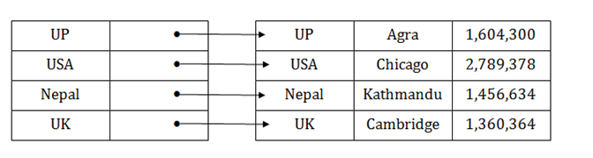
Dense index:
The dense index contains an index record for every search key value in the data file. It makes searching faster.
In this, the number of records in the index table is same as the number of records in the main table.
It needs more space to store index record itself. The index records have the search key and a pointer to the actual record on the disk.

Slide 59
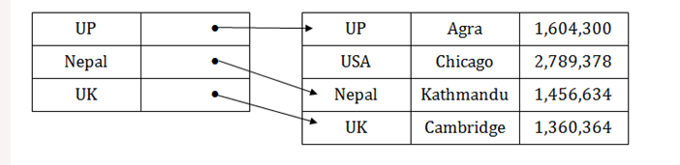
Sparse index
in the data file, index record appears only for a few items. Each item points to a block.
In this, instead of pointing to each record in the main table, the index points to the records in the main table in a gap.

Slide 60
Secondary Index
In the sparse indexing, as the size of the table grows, the size of mapping also grows. These mappings are usually kept in the primary memory so that address fetch should be faster. Then the secondary memory searches the actual data based on the address got from mapping. If the mapping size grows then fetching the address itself becomes slower. In this case, the sparse index will not be efficient. To overcome this problem, secondary indexing is introduced.

Slide 61
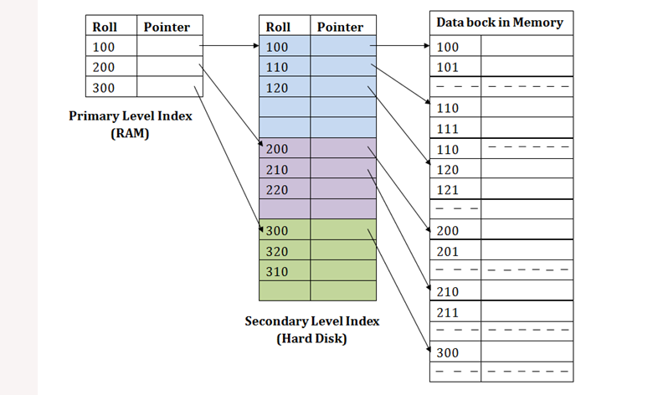

Slide 62
In secondary indexing, to reduce the size of mapping, another level of indexing is introduced. In this method, the huge range for the columns is selected initially so that the mapping size of the first level becomes small. Then each range is further divided into smaller ranges. T

Slide 63
Tree based Indexing
❖ The data entries are arranged in sorted order by search key value.  A hierarchical search data structure (tree) is maintained that directs searches to the correct page of data entries.
Trees: Tree A structure with a unique starting node (the root), in which each node is capable of having child nodes and a unique path exists from the root to every other node
Root The top node of a tree structure; a node with no parent
Leaf Node A tree node that has no children

Slide 64
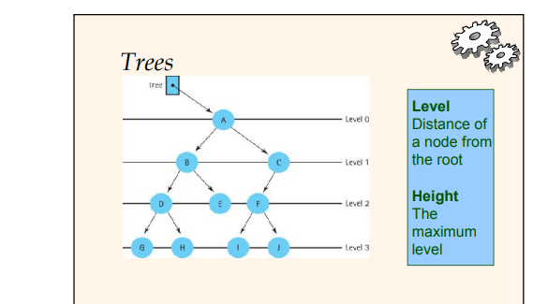

Slide 65
B⁺ Tree
A B⁺ tree is a balanced binary search tree that follows a multi-level index format. The leaf nodes of a B⁺ tree denote actual data pointers. B⁺ tree ensures that all leaf nodes remain at the same height, thus balanced. Additionally, the leaf nodes are linked using a link list; therefore, a B⁺ tree can support random access as well as sequential access.

Slide 66
In the B+ tree, leaf nodes denote actual data pointers. B+ tree ensures that all leaf nodes remain at the same height.
In the B+ tree, the leaf nodes are linked using a link list. Therefore, a B+ tree can support random access as well as sequential access.
Structure of B+ Tree
In the B+ tree, every leaf node is at equal distance from the root node. The B+ tree is of the order n where n is fixed for every B+ tree.
It contains an internal node and leaf node.

Slide 67
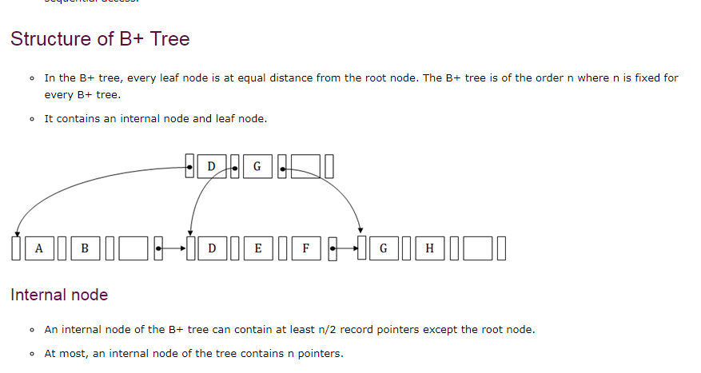

Slide 68
Leaf node
The leaf node of the B+ tree can contain at least n/2 record pointers and n/2 key values.
At most, a leaf node contains n record pointer and n key values.
Every leaf node of the B+ tree contains one block pointer P to point to next leaf node.

Slide 69
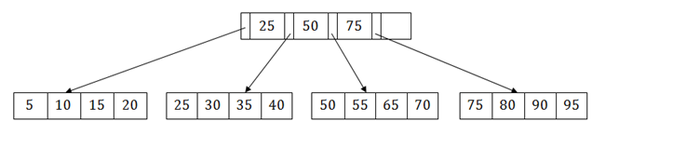
Searching a record in B+ Tree Suppose we have to search 55 in the below B+ tree structure. First, we will fetch for the intermediary node which will direct to the leaf node that can contain a record for 55. So, in the intermediary node, we will find a branch between 50 and 75 nodes. Then at the end, we will be redirected to the third leaf node. Here DBMS will perform a sequential search to find 55.

Slide 70
Advantage –
A B+ tree with ‘l’ levels can store more entries in its internal nodes compared to a B-tree having the same ‘l’ levels. This accentuates the significant improvement made to the search time for any given key. Having lesser levels and presence of P_{next} pointers imply that B+ tree are very quick and efficient in accessing records from disks.

Slide 71
Data Dictionary
A data dictionary (also called the metadata) is the data about the data. It is the self describing nature of the database that provides program-data independence. It is also called as the System Catalog. It holds the information about each data element in the databases.
It does not contain the information of the actual data of the database. Without the presence of a data dictionary, a database management system cannot access the data from the database.

Slide 72
The data dictionary contains the following information:
• It contains the names of all the tables and schemas present in the database.
• It contains the details about the tables which are present in the database like when the tables were created, owner information about the tables, etc.
• It contains the information about the constraints of the tables like primary key attribute.
• It also contains the information about the views of the database.

Slide 73
Functions of the data dictionary
Its function is as follows:
• It defines the data objects of each user in the database. As we know, we cannot remember all the tables, views, constraints, etc., so the user can easily search them when any Data Definition Language (DDL) fired, then the database searches for the data dictionary. The DBMS software updates the object.
• It gives us the report about the data and the resources which the objects are using

Slide 74
Advantages of the data dictionary
• The data dictionary used so that we can remove the duplicacy in the data definition.
• As it provides documentation. So it is a valuable reference for any organization.
• It helps the analysts in simplifying the structure so that it can meet the requirement of the data of the system.
• It helps in improving the communication between the user and the system analyst.
• Maximum of the database management system contains the data dictionary as a standard feature.
• Through this, new database administrators can easily understand the database of the system.

Slide 75
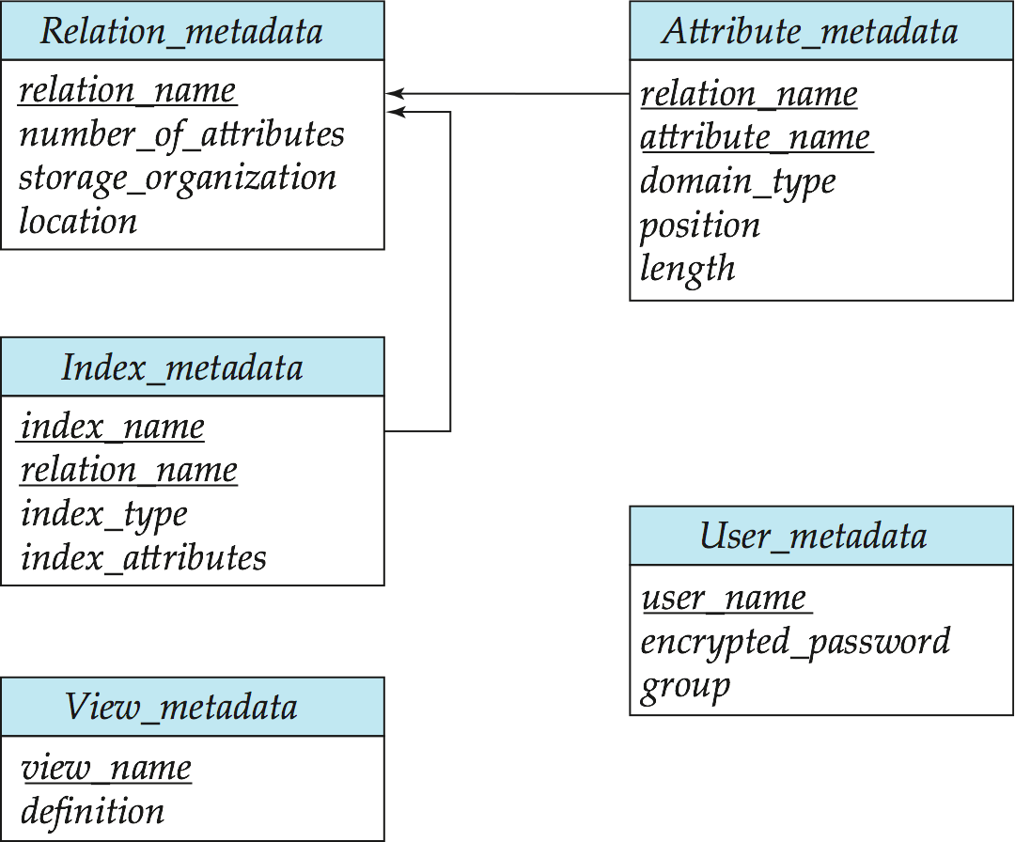
Relational Representation of System Metadata
Relational representation on disk
Specialized data structures designed for efficient access, in memory

Slide 76
Data administration process
Data administration is the process by which data is monitored, maintained and managed by a data administrator and/or an organization. Data administration allows an organization to control its data assets, as well as their processing and interactions with different applications and business processes. Data administration ensures that the entire life cycle of data use and processing is on par with the enterprise’s objective.

Slide 77
Data administration process contd..
Data administration typically involves the logical management of data in which the flow of data is analyzed, data models are created and the relationships among them are defined. Data administration also defines the security and access control elements of data where executive level data might be limited to some people and processes.
Data management differs from database administration in that the former defines the processes used to manage and maintain data as an organizational asset, whereas the latter deals with the technicalities involved with managing and distributing data.

Slide 78
Database administration
Database administration is more of an operational or technical level function responsible for physical database design, security enforcement, and database performance. Tasks include maintaining the data dictionary, monitoring performance, and enforcing organizational standards and security

Slide 79
Database Administration (DBA)
A Database Administrator is a person or a group of person who are responsible for managing all the activities related to database system.
Role, Duties and Responsibilities of database Administrator( DBA)
Managing Data Integrity
Data integrity should be managed accurately because it protects the data from unauthorized use. DBA manages relationship between the data to maintain data consistency.
Decides Data Recovery and Back up method
If any company is having a big database, then it is likely to happen that database may fail at any instance. It is require that a DBA takes backup of entire database in regular time span.

Slide 80
Tuning Database Performance
Database performance plays an important role for any business. If user is not able to fetch data speedily then it may loss company business. So by tuning an modifying sql commands a DBA can improves the performance of database. Monitoring performance
If database is working properly then it doesn’t mean that there is no task for the DBA. Yes f course, he has to monitor the performance of the database. A DBA monitors the CPU and memory usage.
Improve query processing performance
Queries made by the users should be performed speedily. As we have discussed that users need fast retrieval of answers so DBA improves query processing by improving their performance.

Slide 81
Policy Formulation and Implementation
Access Privileges
Users should access the database only in ways in which they are entitled.
Security
Access restrictions ensure that the database is secure.
Passwords, encryption, and views implement security.
Effective password protection is critical.

Slide 82
Planning for Disaster
Databases can be harmed from hardware and software malfunctions, and outsides forces like floods and power outages.
DBA’s must take active role in formulating disaster recovery plans.

Slide 83
Data Dictionary Management
Essentially the catalog, but it contains a wider range of information, including information on tables, fields, indexes, and programs.
The DBA manages and updates the data dictionary, which establishes naming conventions for tables, fields, etc., and data integrity rules.

Slide 84
Additional responsibilities of DBA
Training
DBA gives training on the DBMS and how to access the database
DBMS Support
The DBA is charged with all aspects of a DBMS, including selection and management
DBA must evaluate each prospective DBMS using a checklist like that shown in
Database design
DBA is responsible for tuning the design, i.e., making changes that improve system performance.

